Slide 1
Visão Computacional e Processamento de Imagens
Prof. André Gustavo Hochuli
gustavo.hochuli@pucpr.br
aghochuli@ppgia.pucpr.br
Notes:
Prof. André Hochuli

Slide 2
Tópicos
Revisão Aula 01
Visão Computacional
Definições de Imagem
Sistemas de Cor
Convolução e Filtros
Extração de Componentes
Descritores de Características (Introdução)
Visão Computacional - Prof. André Hochuli
Aula 02
Notes:
Prof. André Hochuli

Slide 3
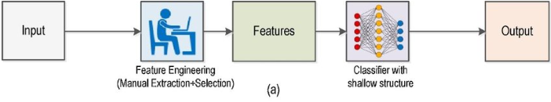
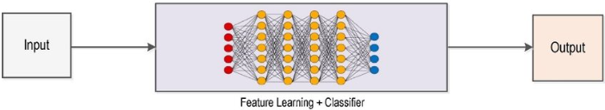
Visão Computacional Pipeline
Abordagem Tradicional (~2010)
Deep Learning (~2010->Hoje)
Visão Computacional - Prof. André Hochuli
Aula 02
Notes:
Prof. André Hochuli

Slide 4
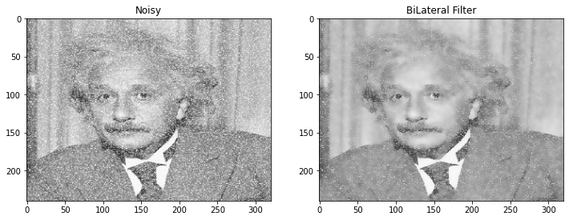
Filtros de Imagem
_{Aprimoramento de Imagens}
_{Redução de Ruídos}
_{Operações Matemáticas}
Computer Vision - Prof. André Hochuli
Lecture 02
Notes:
Prof. André Hochuli

Slide 5
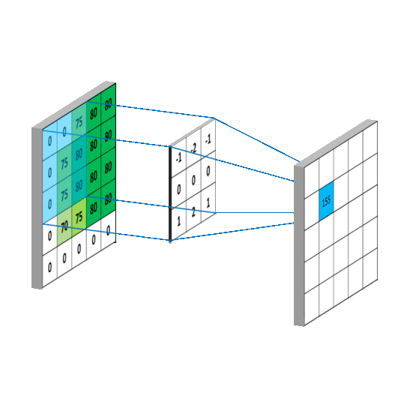
Convolução
Deslizar um Kernel (Filtro Convolucional) sobre a imagem
_{Stride, Kernel Size, Weigths}
Transforma o pixel central a partir dos pesos do kernel sobre a vizinhança do pixel
Computer Vision - Prof. André Hochuli
Lecture 02
Notes:
Prof. André Hochuli

Slide 6
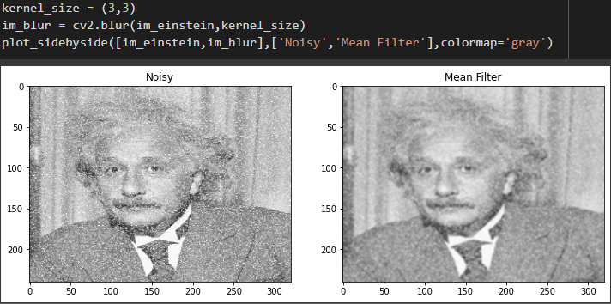
Filtro da Média
Substitui o pixel central pela sua média
Espalha o ruído (outlier) pela vizinhança
_{Detalhes são suavizados}
Computer Vision - Prof. André Hochuli
Lecture 02
Notes:
Prof. André Hochuli

Slide 7
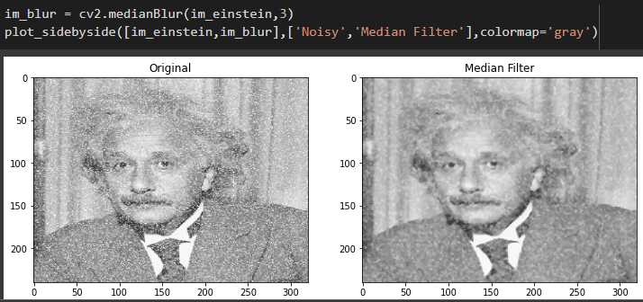
Filtro da Mediana
Substitui o pixel central pela mediana vizinhança
Preserva melhor os detalhes do que comparado a média
Computer Vision - Prof. André Hochuli
Lecture 02
Notes:
Prof. André Hochuli

Slide 8

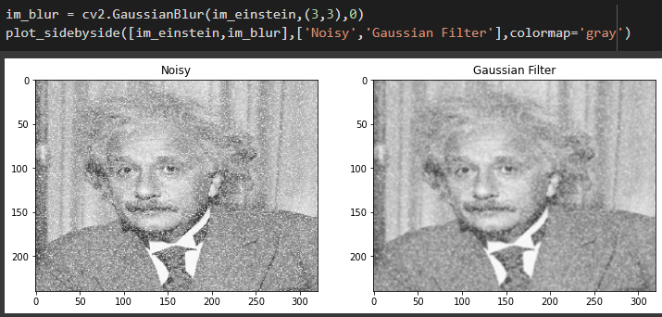
Filtro Gaussiano
Distribuição Gaussiana dos Pixeis
Os pesos são compostos por distribuições
_{Media Ponderada}
Desvio padrão determina o grau do filtro.
Computer Vision - Prof. André Hochuli
Lecture 02
Notes:
Prof. André Hochuli

Slide 9
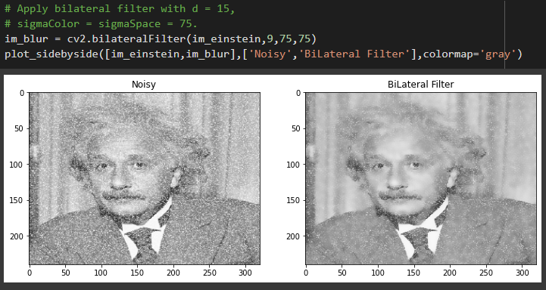
Filtro Bilateral
Baseado em distribuição gaussiana
_{Normalização dos fatores}
_{Preserva detalhes}
Computer Vision - Prof. André Hochuli
Lecture 02
Notes:
Prof. André Hochuli

Slide 10


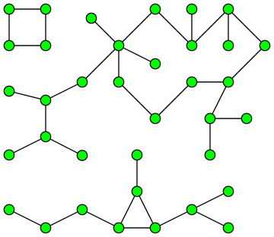

Segmentação de Componentes
Componentes Conexos
Aplicação oriunda em teoria de grafos
Redes Sociais
Biologia
Reconhecimento de Padrões
Computer Vision - Prof. André Hochuli
Lecture 04
Notes:
Prof. André Hochuli

Slide 11



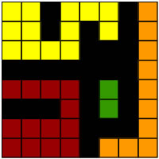
Connected Component Labelling
Analyzes the non-zero pixel's neighborhood (foreground)
Label each connected pixel with a label (1,2,3,4….)
Kernels:
4-Neighboors
8-Neighboors
Computer Vision - Prof. André Hochuli
Lecture 04
Notes:
Prof. André Hochuli

Slide 12

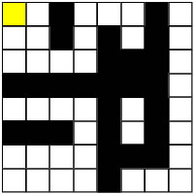
Row by Row Algorithm
Sliding a connectivity kernel , row by row ( 2 passes)
If the center falls in a non-zero pixel, label it!
Labeling:
If there are no labeled pixels connected, attribute a new label
Otherwise, attribute to it the neighbor´s label.
A Union-Find structure control adjacent labels (Union-Find)
Pass #1:
Row #1
Computer Vision - Prof. André Hochuli
Lecture 04
Notes:
Prof. André Hochuli

Slide 13

Row by Row Algorithm
Sliding a connectivity kernel , row by row ( 2 passes)
If the center falls in a non-zero pixel, label it!
Labeling:
If there are no labeled pixels connected, attribute a new label
Otherwise, attribute to it the neighbor´s label.
A Union-Find structure control adjacent labels (Union-Find)
Pass #1:
Row #1
Computer Vision - Prof. André Hochuli
Lecture 04
Notes:
Prof. André Hochuli

Slide 14
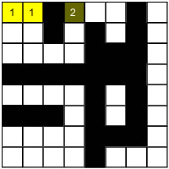
Row by Row Algorithm
Sliding a connectivity kernel , row by row ( 2 passes)
If the center falls in a non-zero pixel, label it!
Labeling:
If there are no labeled pixels connected, attribute a new label
Otherwise, attribute to it the neighbor´s label.
A Union-Find structure control adjacent labels (Union-Find)
Pass #1:
Row #1
Computer Vision - Prof. André Hochuli
Lecture 04
Notes:
Prof. André Hochuli

Slide 15
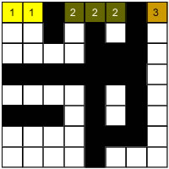
Row by Row Algorithm
Sliding a connectivity kernel , row by row ( 2 passes)
If the center falls in a non-zero pixel, label it!
Labeling:
If there are no labeled pixels connected, attribute a new label
Otherwise, attribute to it the neighbor´s label.
A Union-Find structure control adjacent labels (Union-Find)
Pass #1:
Row #1
Computer Vision - Prof. André Hochuli
Lecture 04
Notes:
Prof. André Hochuli

Slide 16
Row by Row Algorithm
Sliding a connectivity kernel , row by row ( 2 passes)
If the center falls in a non-zero pixel, label it!
Labeling:
If there are no labeled pixels connected, attribute a new label
Otherwise, attribute to it the neighbor´s label.
A Union-Find structure control adjacent labels (Union-Find)
Pass #1:
Row #1
Computer Vision - Prof. André Hochuli
Lecture 04
Notes:
Prof. André Hochuli

Slide 17
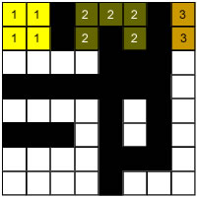
Row by Row Algorithm
Sliding a connectivity kernel , row by row ( 2 passes)
If the center falls in a non-zero pixel, label it!
Labeling:
If there are no labeled pixels connected, attribute a new label
Otherwise, attribute to it the neighbor´s label.
A Union-Find structure control adjacent labels (Union-Find)
Pass #1:
Row #2
Computer Vision - Prof. André Hochuli
Lecture 04
Notes:
Prof. André Hochuli

Slide 18
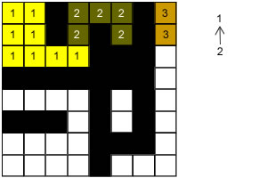
Row by Row Algorithm
Sliding a connectivity kernel , row by row ( 2 passes)
If the center falls in a non-zero pixel, label it!
Labeling:
If there are no labeled pixels connected, attribute a new label
Otherwise, attribute to it the neighbor´s label.
A Union-Find structure control adjacent labels (Union-Find)
Pass #1:
Row #3
Adjacent labels
Union-Find
Computer Vision - Prof. André Hochuli
Lecture 04
Notes:
Prof. André Hochuli

Slide 19
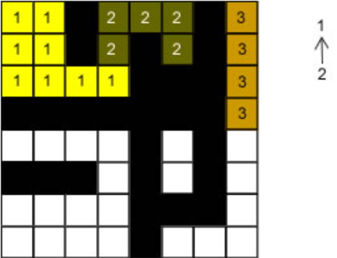
Row by Row Algorithm
Sliding a connectivity kernel , row by row ( 2 passes)
If the center falls in a non-zero pixel, label it!
Labeling:
If there are no labeled pixels connected, attribute a new label
Otherwise, attribute to it the neighbor´s label.
A Union-Find structure control adjacent labels (Union-Find)
Pass #1:
Row #4
Union-Find
Computer Vision - Prof. André Hochuli
Lecture 04
Notes:
Prof. André Hochuli

Slide 20
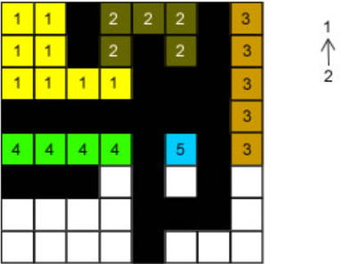
Row by Row Algorithm
Sliding a connectivity kernel , row by row ( 2 passes)
If the center falls in a non-zero pixel, label it!
Labeling:
If there are no labeled pixels connected, attribute a new label
Otherwise, attribute to it the neighbor´s label.
A Union-Find structure control adjacent labels (Union-Find)
Pass #1:
Row #5
Union-Find
Computer Vision - Prof. André Hochuli
Lecture 04
Notes:
Prof. André Hochuli

Slide 21
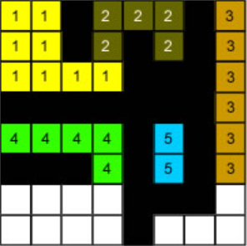
Row by Row Algorithm
Sliding a connectivity kernel , row by row ( 2 passes)
If the center falls in a non-zero pixel, label it!
Labeling:
If there are no labeled pixels connected, attribute a new label
Otherwise, attribute to it the neighbor´s label.
A Union-Find structure control adjacent labels (Union-Find)
Pass #1:
Row #6
Union-Find
Computer Vision - Prof. André Hochuli
Lecture 04
Notes:
Prof. André Hochuli

Slide 22
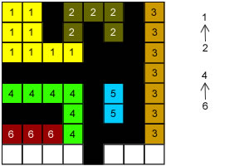
Row by Row Algorithm
Sliding a connectivity kernel , row by row ( 2 passes)
If the center falls in a non-zero pixel, label it!
Labeling:
If there are no labeled pixels connected, attribute a new label
Otherwise, attribute to it the neighbor´s label.
A Union-Find structure control adjacent labels (Union-Find)
Pass #1:
Row #7
Union-Find
Computer Vision - Prof. André Hochuli
Lecture 04
Notes:
Prof. André Hochuli

Slide 23
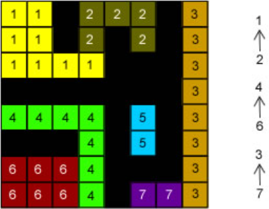
Row by Row Algorithm
Sliding a connectivity kernel , row by row ( 2 passes)
If the center falls in a non-zero pixel, label it!
Labeling:
If there are no labeled pixels connected, attribute a new label
Otherwise, attribute to it the neighbor´s label.
A Union-Find structure control adjacent labels (Union-Find)
Pass #1:
Row #8
Union-Find
Computer Vision - Prof. André Hochuli
Lecture 04
Notes:
Prof. André Hochuli

Slide 24
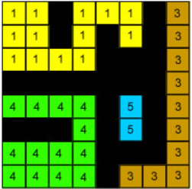
Row by Row Algorithm
Sliding a connectivity kernel , row by row ( 2 passes)
If the center falls in a non-zero pixel, label it!
Labeling:
If there are no labeled pixels connected, attribute a new label
Otherwise, attribute to it the neighbor´s label.
A Union-Find structure control adjacent labels (Union-Find)
Pass #2:
Resolve Union-Find
Union-Find
Computer Vision - Prof. André Hochuli
Lecture 04
Notes:
Prof. André Hochuli

Slide 25
Let’s Code!
In our pratice, we will implement an algorithm to segment characters in a license plate.
Besides, we will introduce the cv2.connectedComponent() that implements the component labeling method
Checkout it here: Lecture 04 - Finding Components.ipynb
Computer Vision - Prof. André Hochuli
Lecture 04
Notes:
Prof. André Hochuli

Slide 26
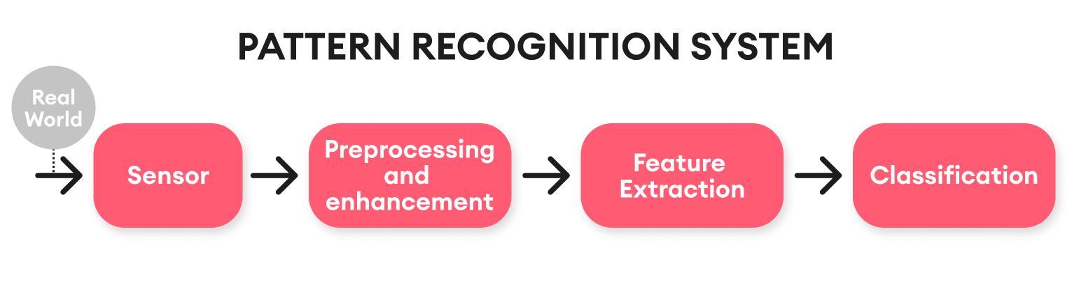
Computer Vision & Pattern Recognition Pipeline
Computer Vision - Prof. André Hochuli
Lecture 05
Notes:
Prof. André Hochuli

Slide 27
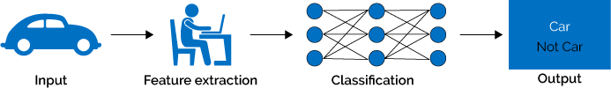
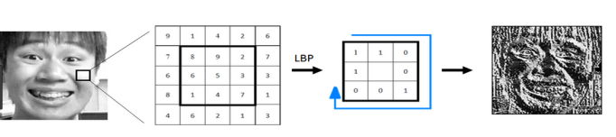
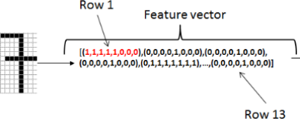
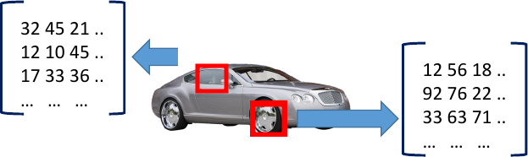
Feature Extraction
A feature descriptor translates high-dimensional data to a feature space
A feature vector represents the input data produced by the feature descriptor
Later, a machine learning model will learn the representations
Computer Vision - Prof. André Hochuli
Lecture 05
Notes:
Prof. André Hochuli

Slide 28

Feature Extraction
Let's represent our image by its size, so an image I that belongs to class X is represented by:
f(I,X) = [I.width,I.heigth,X]
Computer Vision - Prof. André Hochuli
Lecture 05
Notes:
Prof. André Hochuli

Slide 29
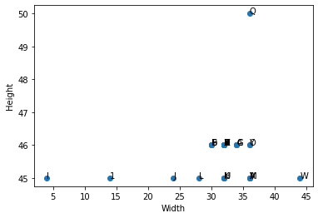
Feature Vector
Is the feature vector representative?
Computer Vision - Prof. André Hochuli
Lecture 05
Notes:
Prof. André Hochuli

Slide 30
Feature Vector
Is the feature vector representative?
Computer Vision - Prof. André Hochuli
Lecture 05
Notes:
Prof. André Hochuli

Slide 31
Feature Vector
Is the feature vector representative?
Computer Vision - Prof. André Hochuli
Lecture 05
Notes:
Prof. André Hochuli

Slide 32
Feature Vector
Is the feature vector representative?
Computer Vision - Prof. André Hochuli
Lecture 05
Notes:
Prof. André Hochuli

Slide 33
Feature Vector
Is the feature vector representative?
Non Discriminative
Computer Vision - Prof. André Hochuli
Lecture 05
Notes:
Prof. André Hochuli

Slide 34
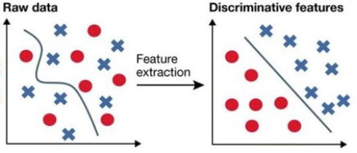
Feature Engineering
How to produce a discriminative feature space?
Features must describe a singular characteristic of the problem for good generalization.
Computer Vision - Prof. André Hochuli
Lecture 05
Notes:
Prof. André Hochuli

Slide 35
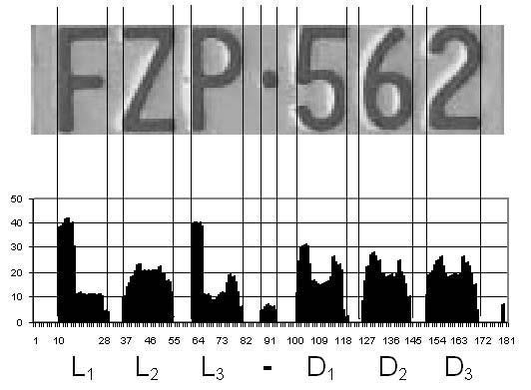
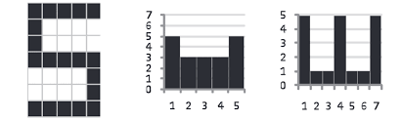

Image Descriptors
Vertical and Horizontal Projection
Computer Vision - Prof. André Hochuli
Lecture 05
Notes:
Prof. André Hochuli

Slide 36
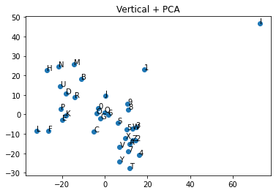
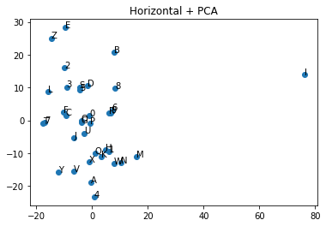
Image Descriptors
Vertical and Horizontal Projection
Computer Vision - Prof. André Hochuli
Lecture 05
Notes:
Prof. André Hochuli

Slide 37
Let’s Code!!
Link
Computer Vision - Prof. André Hochuli
Lecture 05
Notes:
Prof. André Hochuli

